Slide 1
fNIRSandGerbils Update
1-29-2024

Slide 2
From Last time….
Scrambled and Unscrambled masker onsets look similar in amplitude → that’s funky!!!
Could this be an issue with epoching/postprocessing?
Discovered weird triggers that don’t belong
What we’ve done
Emaya combed through triggers, wrote code to remove extraneous triggers
Ben double checked postprocessing
Detrending was present → eek! Now removed
Using the proper color ERP array (this was Ben’s fault for typing “red” instead of “color”)

Slide 3
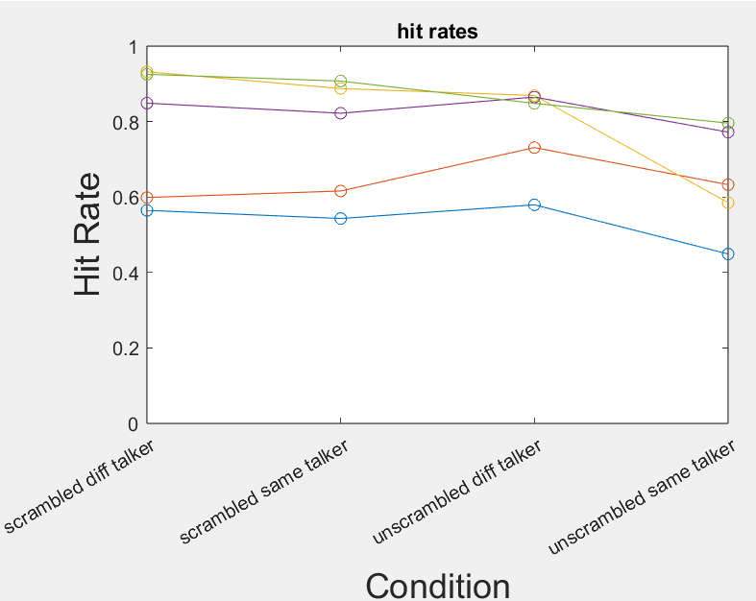
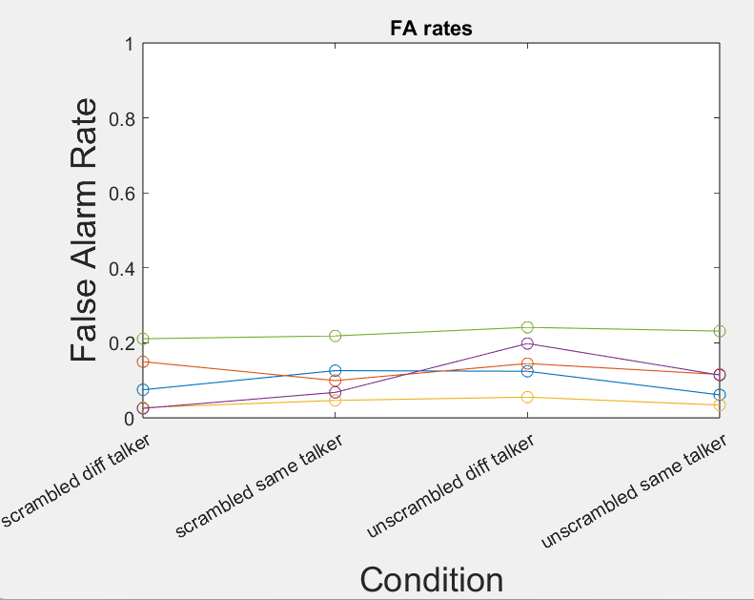
Behavior Data of Five Subjects - Hit and False Alarm Rates

Slide 4
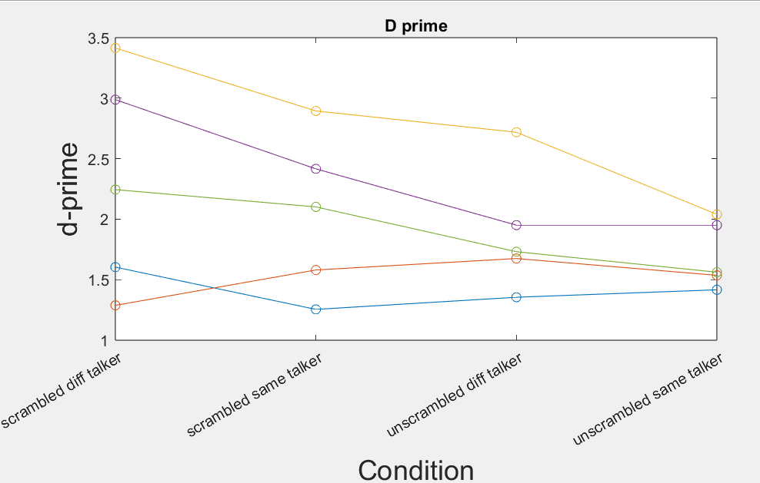
Behavior Data of Five Subjects – D primes

Slide 5
New Results – 1 panel each condition (n=5)

Slide 6
New Results – 1 panel each word type (n=5)

Slide 7
Preprocess, preprocess, preprocess!!!
6 more subjects to process
I still think triggers are wrong

